Slide 1



Slide 2
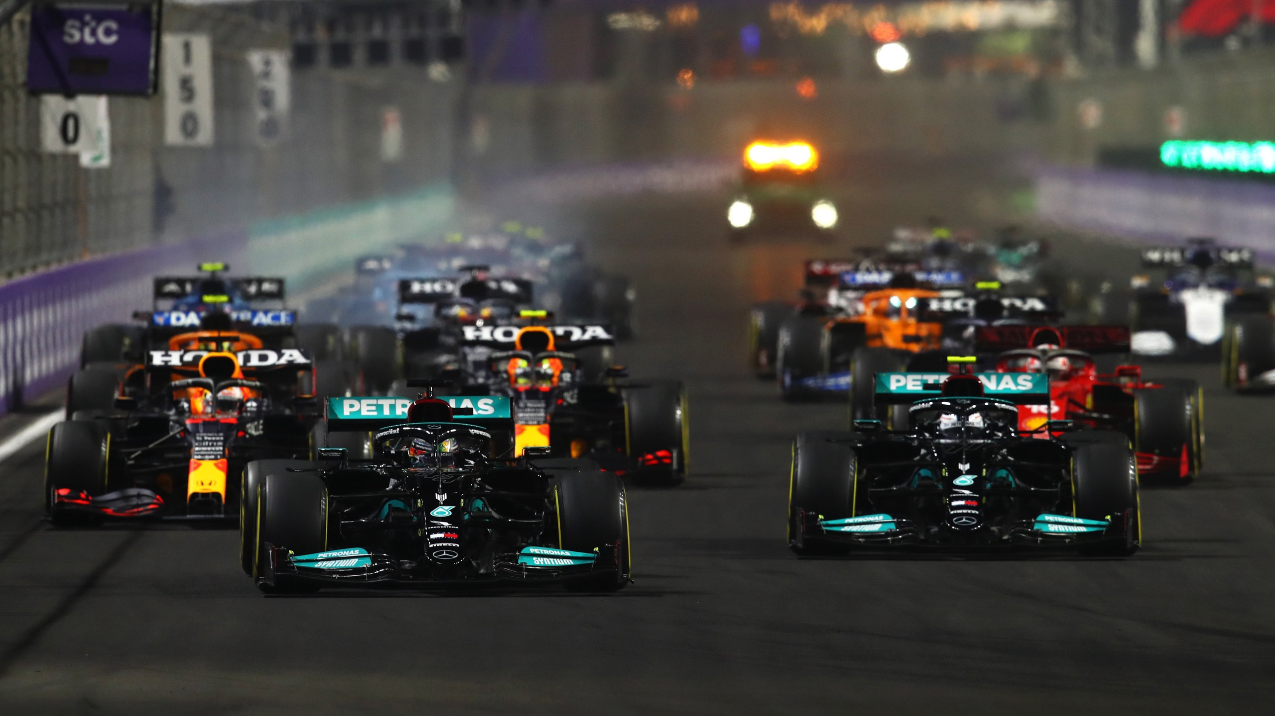

Slide 3
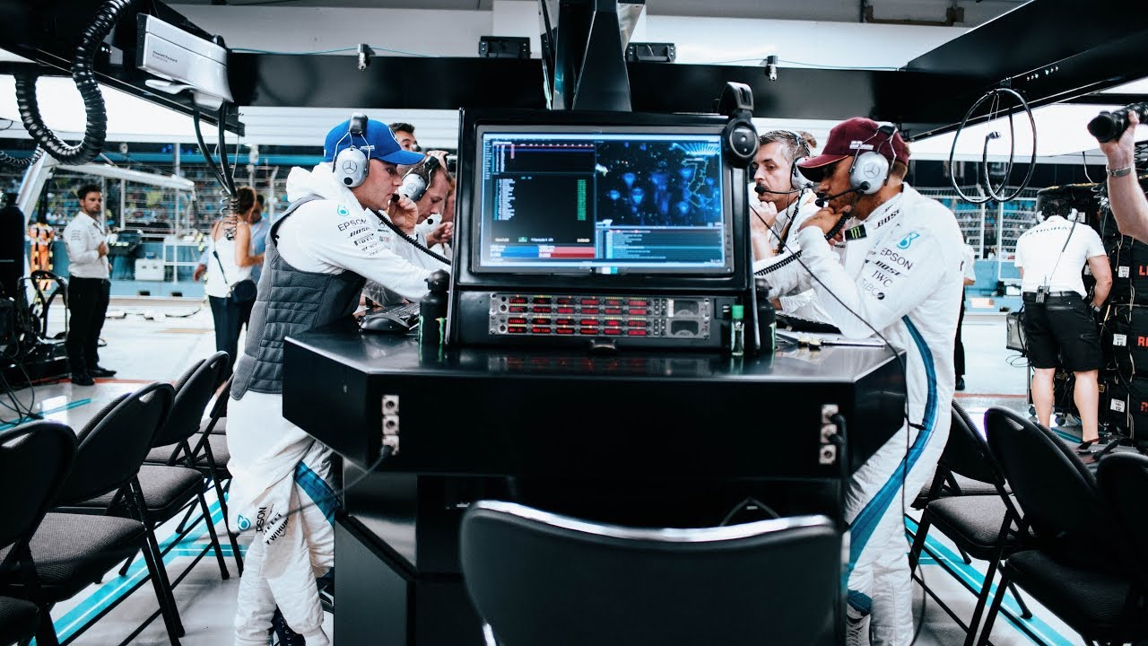
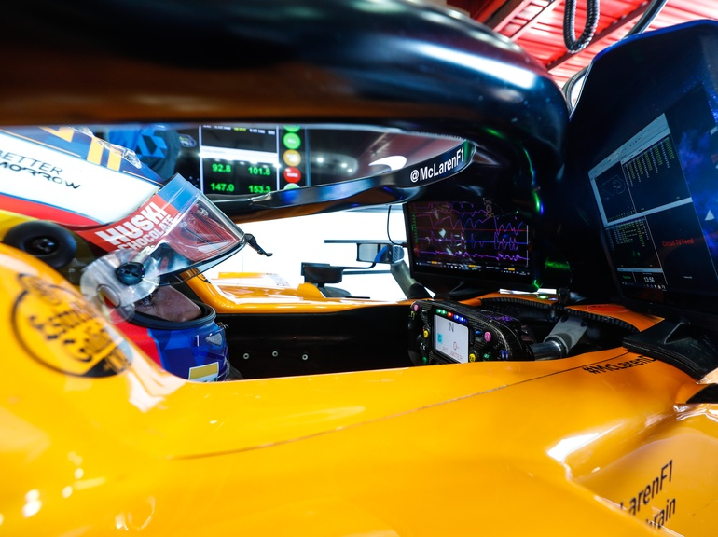
Space of Data in Formula 1
To win races, engineers follow the drivers at each circuit venue to assist them in decision making.
Those engineers on site are complementary with all the engineers back in the formula 1 team’s factory.
Throughout the weekend, even the driver invest time in data analysing to improve his driving skills until Sunday, which is race day.

Slide 4
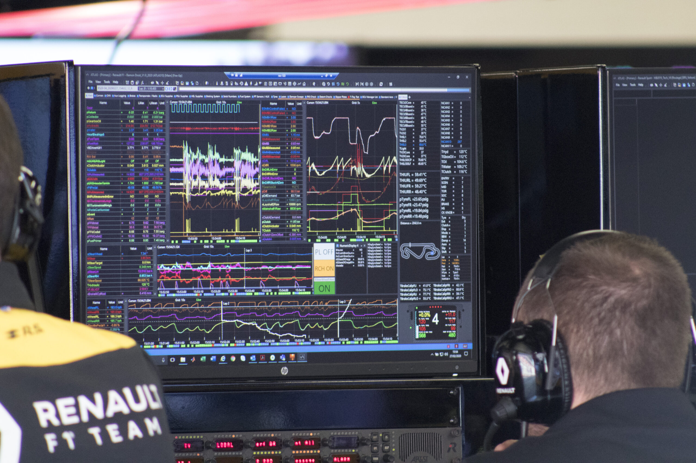

Two different sorts of Data
Internal data : everything related to the car. (Velocity, Shifting, Throttle & Brake pedals, Tyres temperature, Engine status, Gearbox status…)
External data : everything not related to the car. (Weather forecasts, Track temperature & grip condition, Track Flags, Other cars light telemetry…)

Slide 5
Fast F1 Python API
(2.1.12)

Slide 6
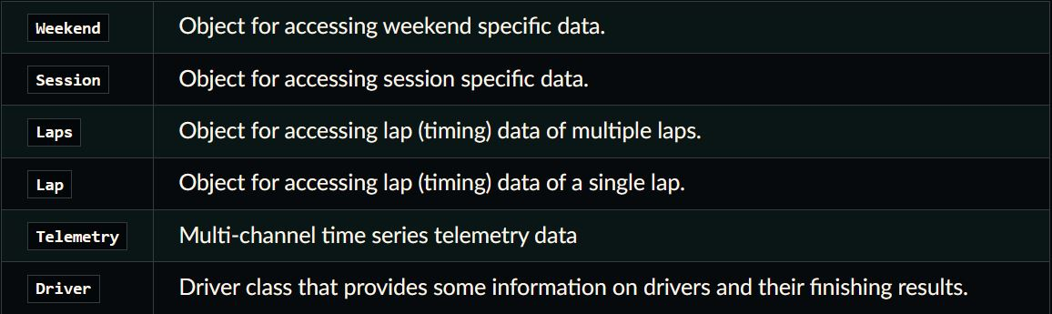
Core

Slide 7
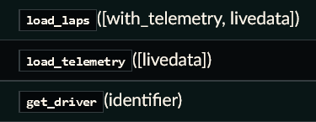
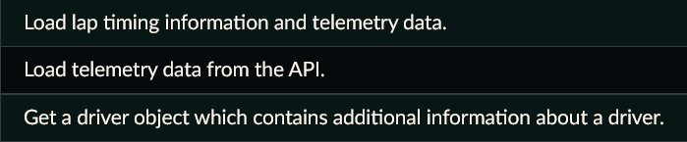
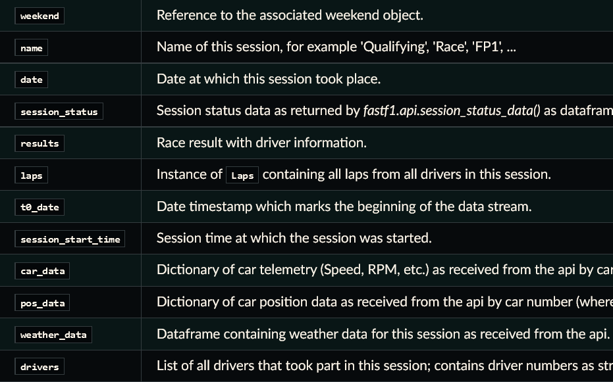
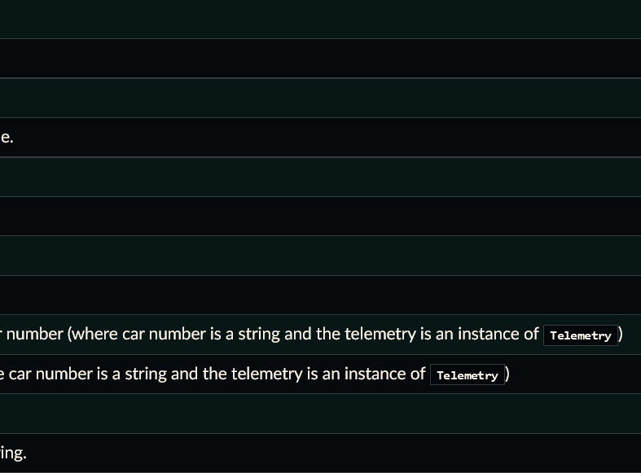
Session class
Methods
Attributes

Slide 8
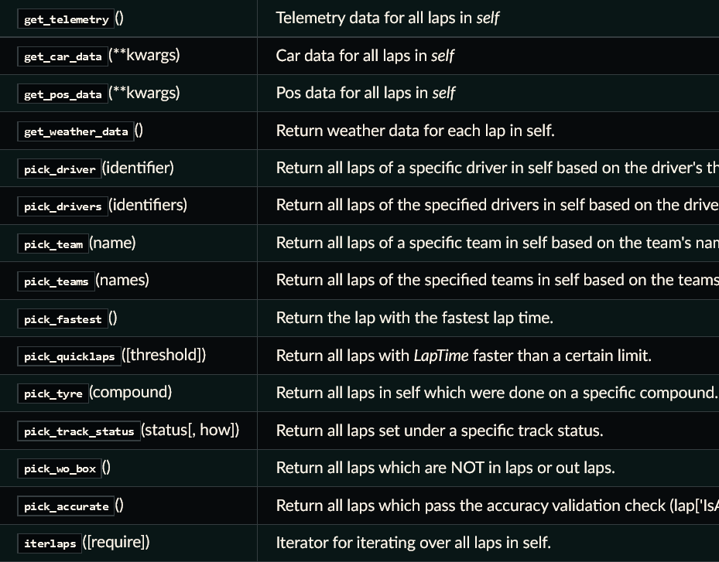
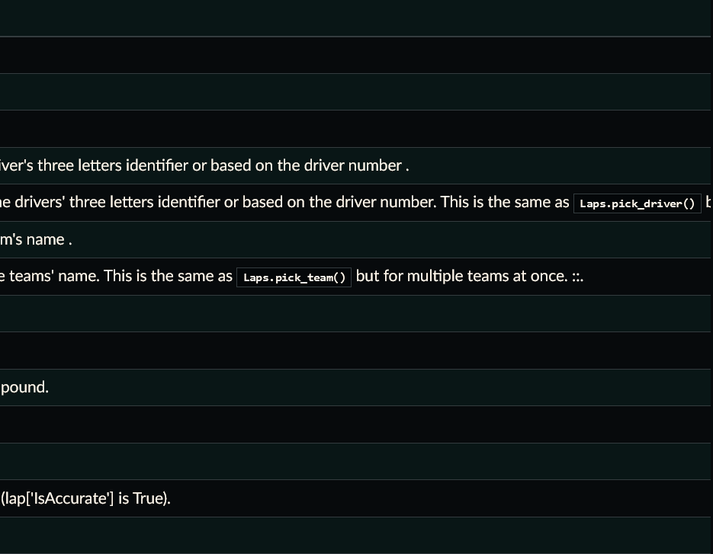
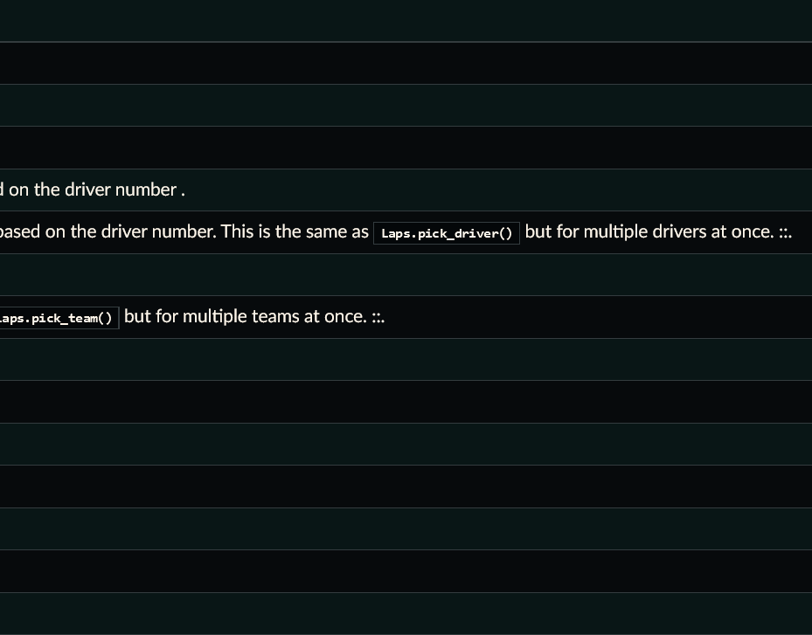
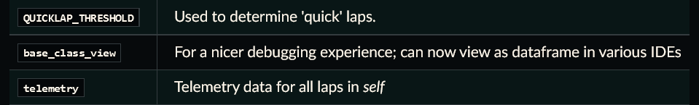
Laps class
Methods
Attributes

Slide 9
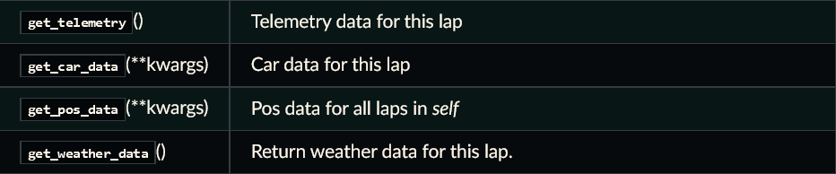
Lap class
Methods
Attributes

Slide 10
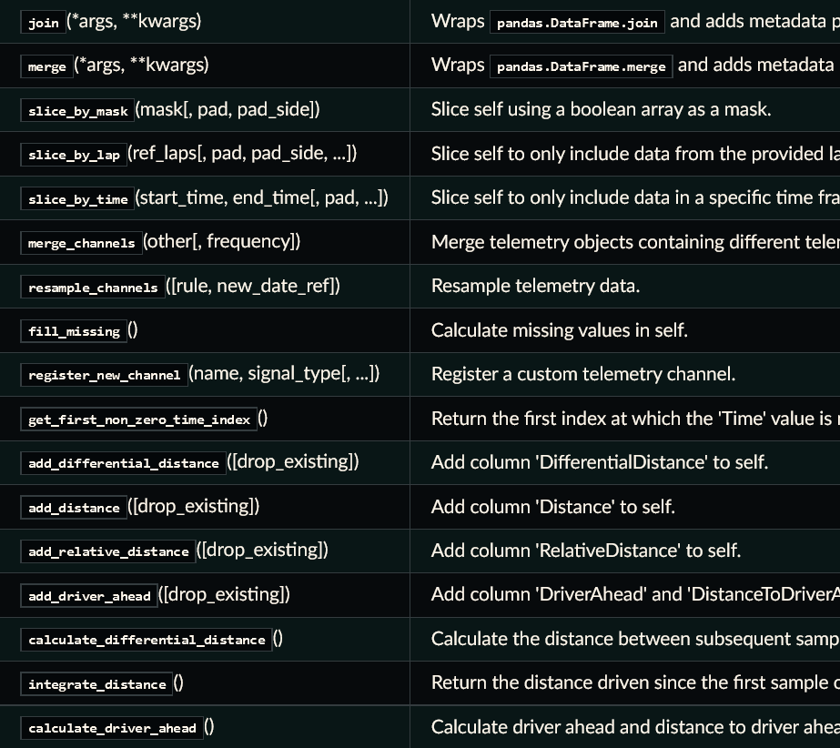
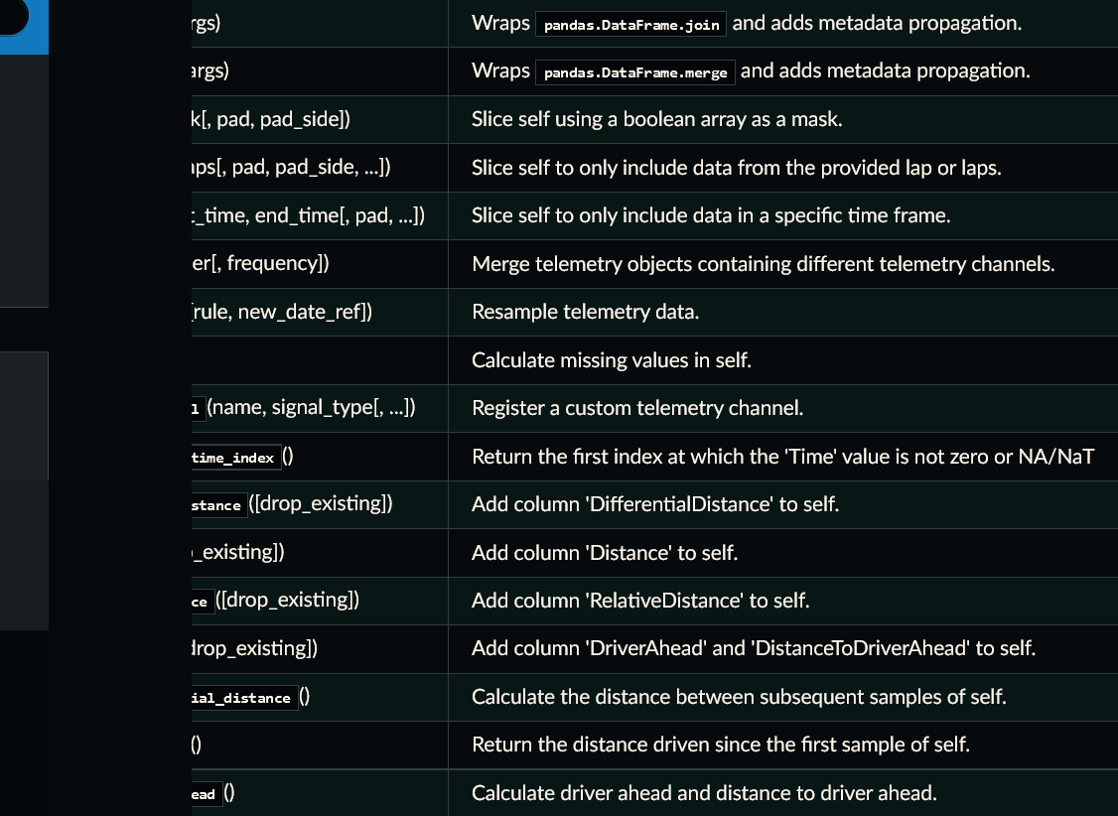
Telemetry class
Methods
Attributes

Slide 11
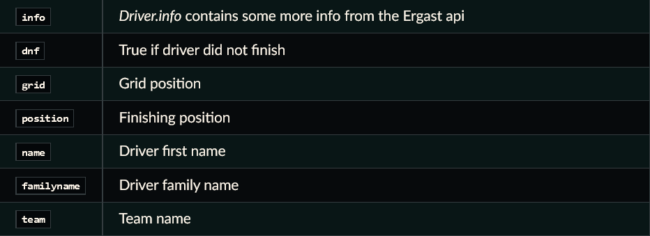
Driver class
Attributes

Slide 15
Appendix Some useful information about F1 race weekends to understand every abbreviation

Slide 16
Race weekend timeline
-- Traditional Format --
-- 2021 Sprint Format --
Friday
Practice 1/2 (P1/P2)
Friday
Practice 1 (P1) Qualification (Q)
Saturday
Practice 3 (P3) Qualification (Q)
Saturday
Practice 2 (P2) Sprint Race (SR)
Sunday
Race (R)
Sunday
Race (R)

Slide 17
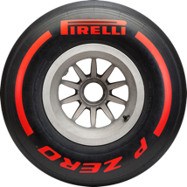
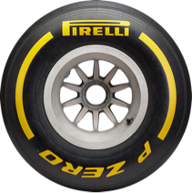
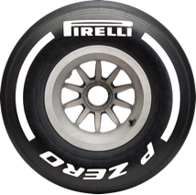
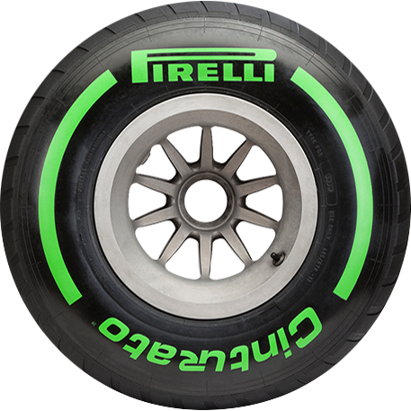
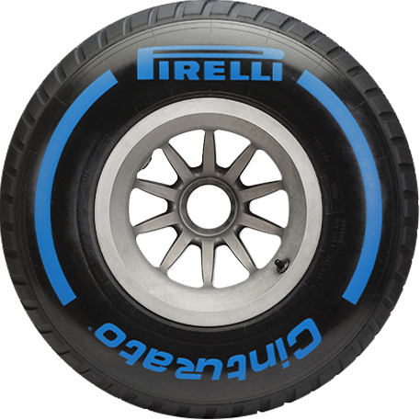
Tyre compounds
Soft tyre : dry conditions, fastest, shortest lifetime
Medium tyre : dry conditions, speed and lifetime balance
Hard tyre : dry conditions, slowest, longest lifetime, harder to heat up
Intermediate tyre : damp conditions, can’t handle too much standing water, vulnerable to overheat on a dry track
Wet tyre : wet or soaked conditions, super effective against standing water, instantly worn on a dry track

Slide 18
Other slides for any other F1 language to be explained

